Slide 1
INTERNATIONAL FINANCIAL MANAGEMENT
UNIT- 4
BY
ARTI (MBA)
HINDU INSTITUTE OF MANAGEMENT & TECHNOLOGY, ROHTAK

Slide 2
Foreign portfolio investment
Foreign portfolio investment is purchasing securities of foreign countries, such as stock and bonds, on an exchange.
Direct investment is seen as a long-term investment in the country's economy, while portfolio investment can be viewed as a short-term move to make money.

Slide 3
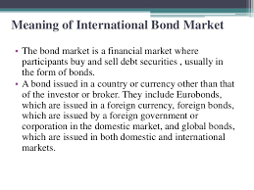
Meaning of International Bond Market:

Slide 4
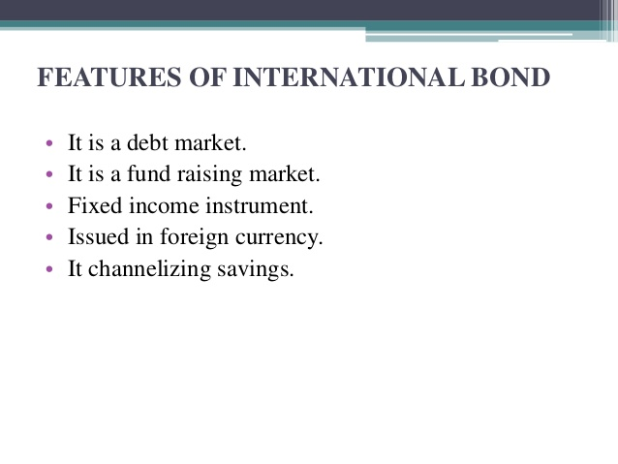
Features Of International Bond:

Slide 5
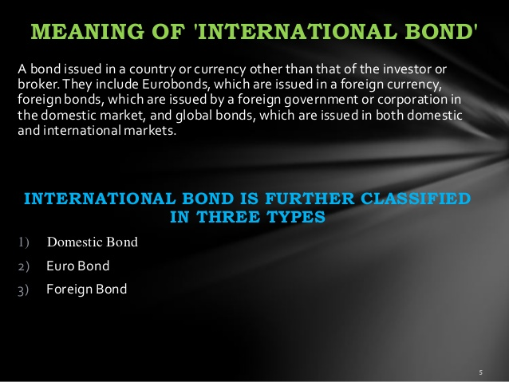

Slide 6
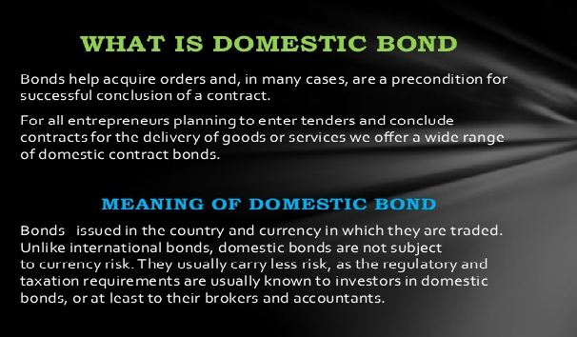

Slide 7
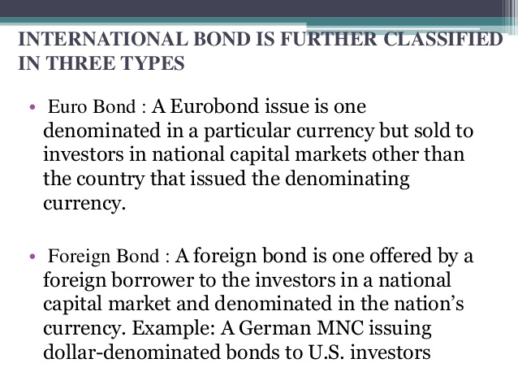

Slide 8
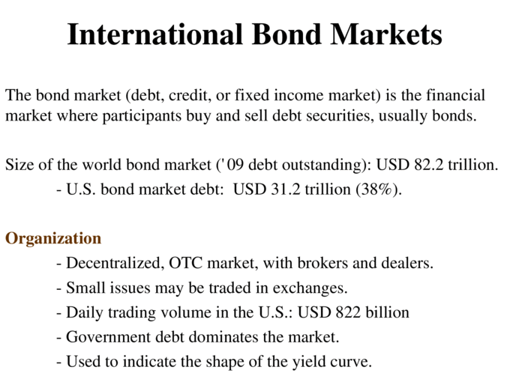

Slide 9
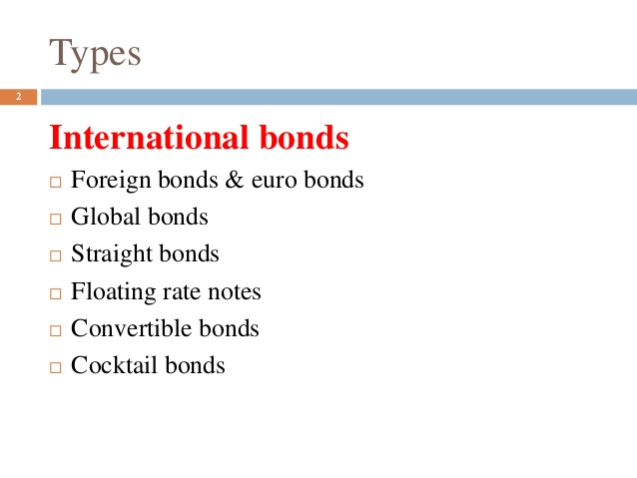

Slide 10
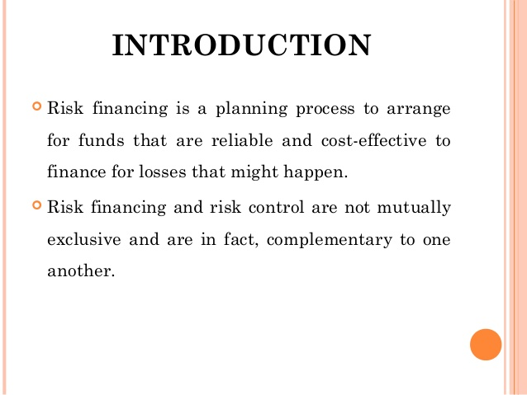
2. COST & RISK FINANCING:

Slide 11
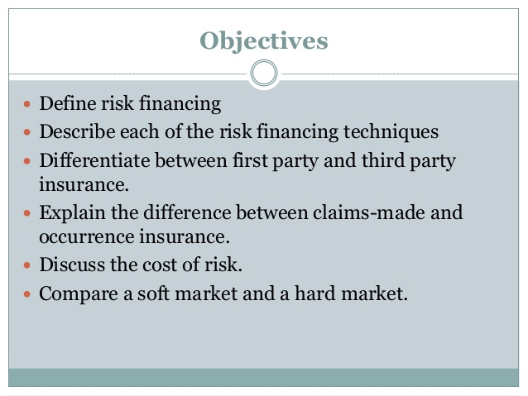
Objectives

Slide 12
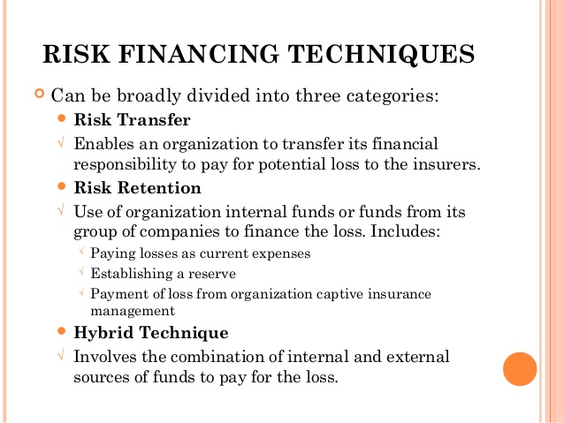
Risk financing techniques

Slide 13
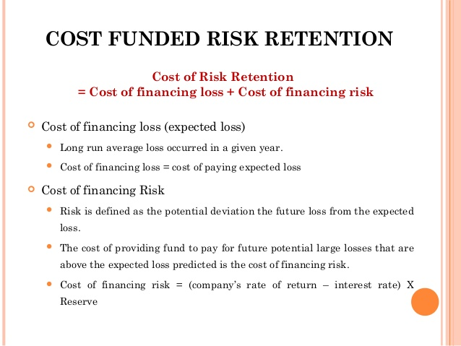
Cost funded risk retention:

Slide 14
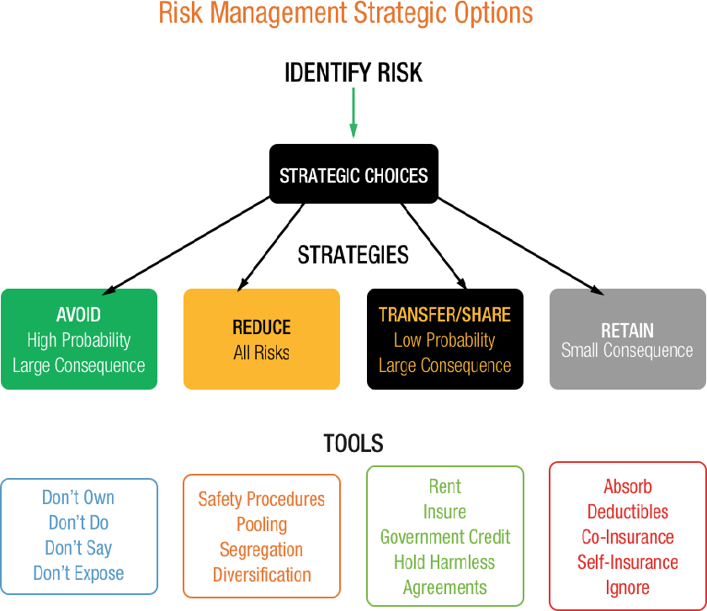

Slide 15
International Portfolio Diversification:
International portfolio diversification is an investment strategy which allows an investor to reduce portfolio risk by holding domestic and foreign financial assets
simultaneously. International investors prefer to hold a global portfolio containing assets of both developed and emerging stock markets.

Slide 16
Barriers to international diversification
Market Risk
Political Risk
Currency Risk
Market efficiency Risk
Cost
Information difficulties
Tax problems

Slide 17
Financial Structure of Foreign Subsidiaries of MNCS
Subsidiaries of Multinational companies also face interest rate fluctuations on the loans taken in the host country. Remittances of MNC subsidiaries depend upon the prevailing currency rate in the host Nation. Capital raising structure of MNC companies depends on the attitude of the government

Slide 18
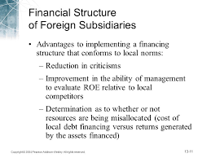

Slide 19
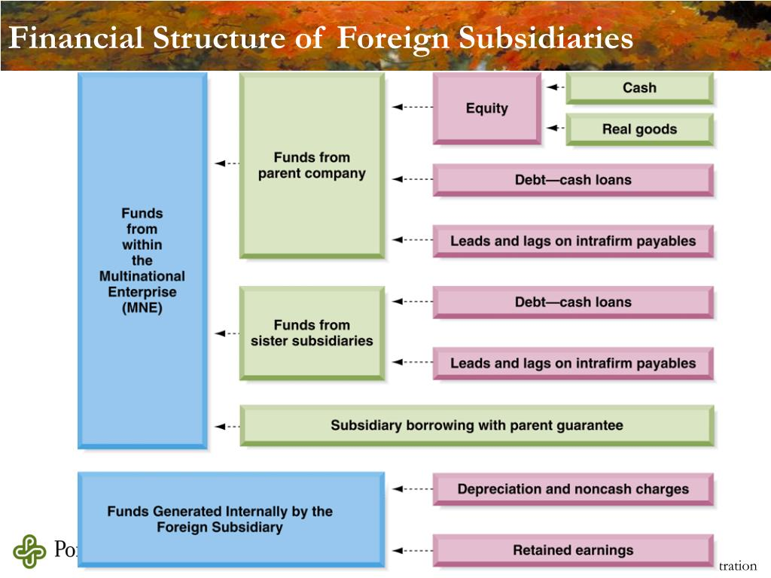

Slide 20
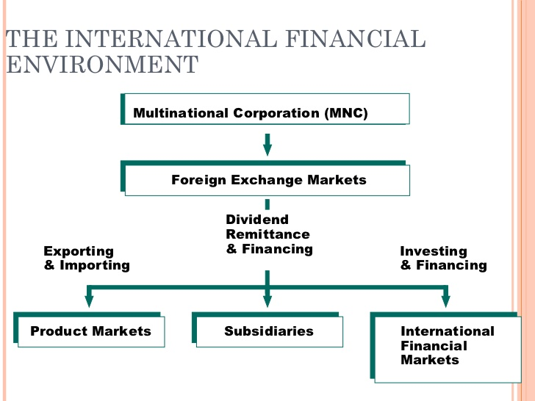

Slide 21
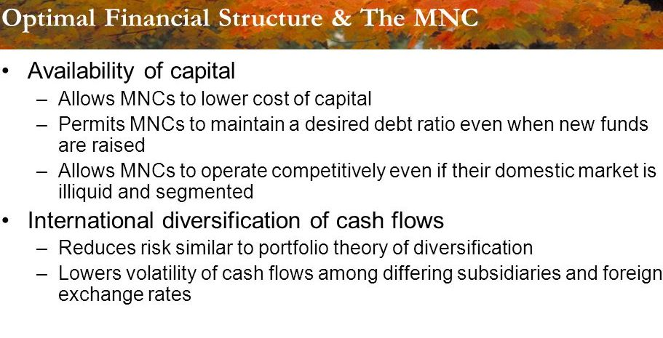

Slide 22


